Slide 1
Integration using trapezoidal rule
Course Instructor
Engr. Rahemeen
Rahemeen.bukc@bahria.edu.pk

Slide 2
Trapezoidal Rule
Forward
In mathematics, the trapezoidal rule, also known as the trapezoid rule is a technique for approximating the definite integral in numerical analysis.
The trapezoidal rule is an integration rule used to calculate the area under a curve by dividing the curve into small trapezoids.
Under the trapezoidal rule, we evaluate the area under a curve is by dividing the total area into little trapezoids rather than rectangles.
This rule is used for approximating the definite integrals where it uses the linear approximations of the functions. The trapezoidal rule takes the average of the left and the right sum.

Slide 3
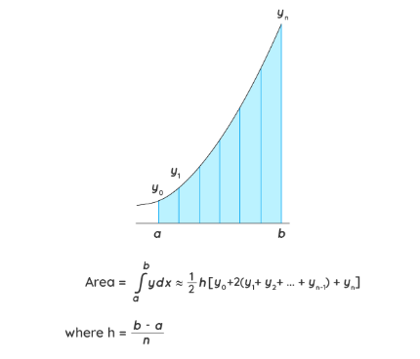
Let y = f(x) be continuous on [a, b]. We divide the interval [a, b] into n equal subintervals, each of width, h = (b - a)/n,
Area = (h/2) [y0 + 2 (y1 + y2 + y3 + ..... + yn-1) + yn] where,
y0, y1,y2…. are the values of function at x = 1, 2, 3….. respectively.

Slide 4
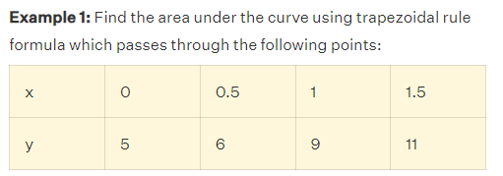
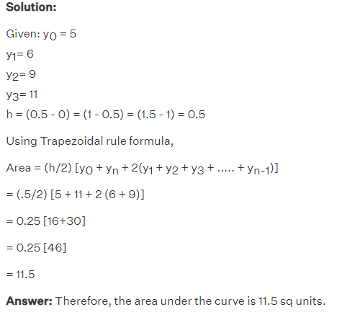
Example

Slide 5

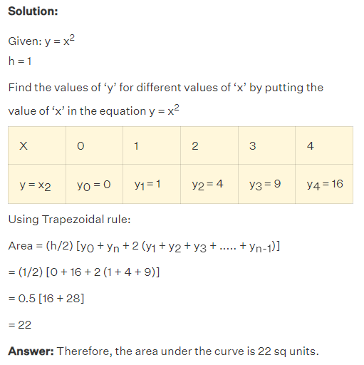

Slide 6
Application
https://www.showme.com/sh/?h=bkzczGC

Slide 7


Exercises
Question # 01:
Approximate the area under the curve :
between x=1 and x=5 using the Trapezoidal Rule with n=4 subintervals.
Question # 02:
Use the Trapezoidal Rule with n=6 to approximate

